Slide 1



Digital Electronics
Class X
lab 17

Slide 2
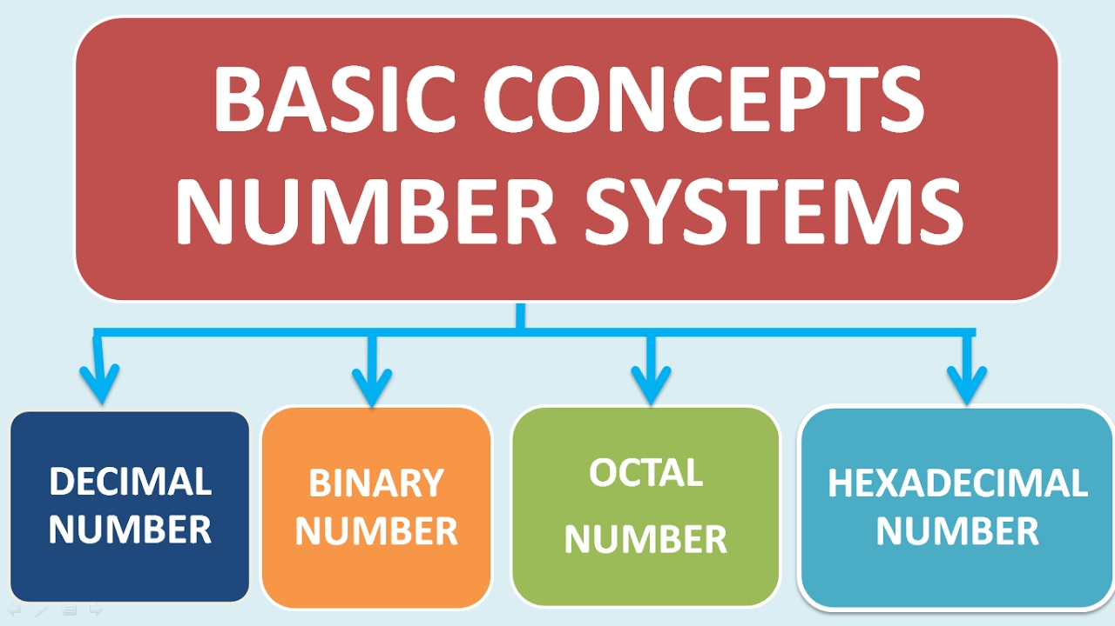
Number Systems
If base or radix of a number system is ‘r’, then the numbers present in that number system are ranging from zero to r-1.

Slide 3
Decimal Number System
The base or radix of Decimal number system is 10. So, the numbers ranging from 0 to 9 are used in this number system

Slide 4
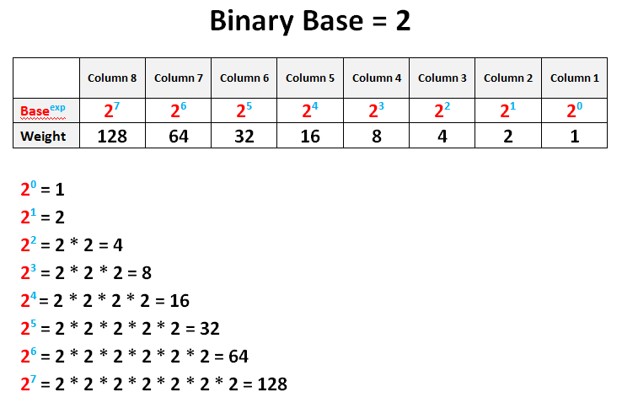
Binary Number System
The base or radix of this number system is 2. So, the numbers 0 and 1 are used in this number system

Slide 5
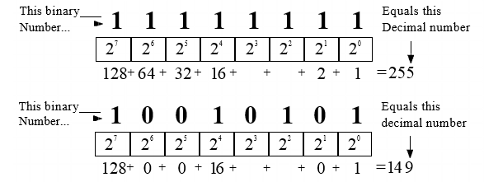
Binary to Decimal

Slide 6
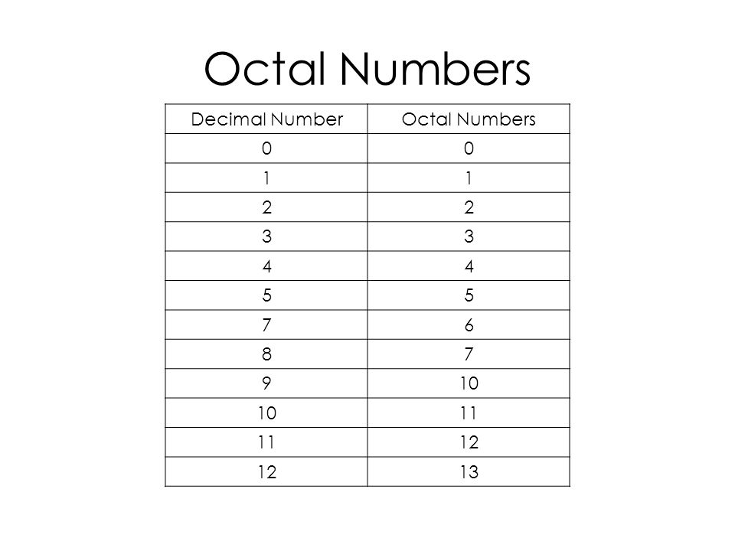
Octal Number System
The base or radix of octal number system is 8. So, the numbers ranging from 0 to 7 are used in this number system

Slide 7
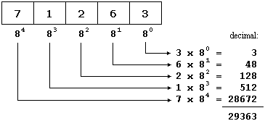
Decimal to Octal

Slide 8
Octal to Decimal

Slide 9
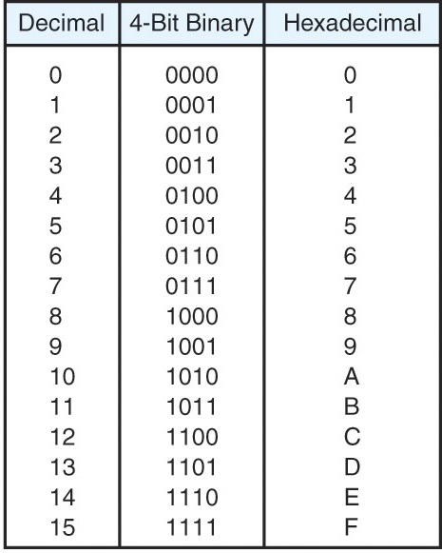
Hexadecimal Number System
The base or radix of Hexa-decimal number system is 16. So, the numbers ranging from 0 to 9 and the letters from A to F are used in this number system

Slide 10
Thank You

